Slide 1

Spatial Database and QGIS Project
Exploring Tourism Amenities in Ireland

Slide 2
Introduction
• This project explores the relationships between tourist places and nearby amenities.
• Focused on restaurants, hotels, and public transport.
• Objective: Demonstrate how spatial databases and QGIS provide valuable insights.

Slide 3
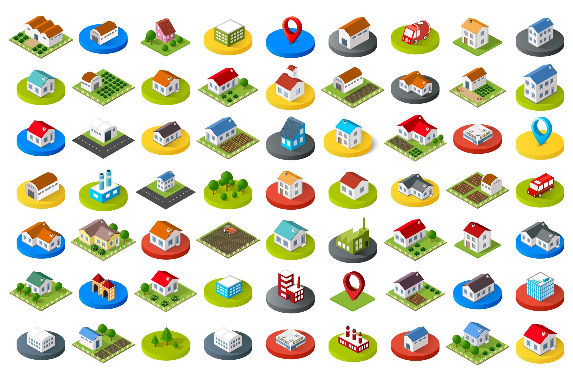
Background and Context
Datasets used:
1. Tourist Places – Points of interest for visitors.
2. Restaurants – Dining options for tourists.
3. Hotels – Accommodations near tourist places.
4. Public Transport – Accessibility options like bus stops.
Why this analysis is important:
• Helps in tourism and urban planning.
• Highlights areas for infrastructure improvement.

Slide 4
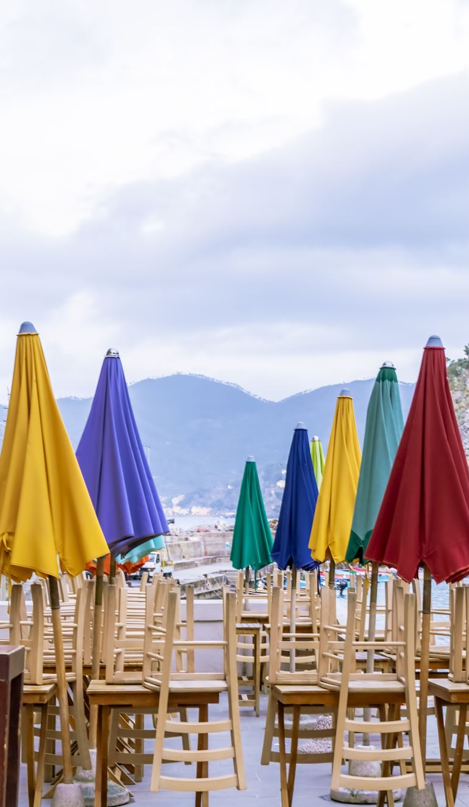
Query 1: Restaurants Near Tourist Places
• Identifies restaurants within 500 meters of tourist places.
• Output: Nearest restaurants and their distances.
• Visualization: Red markers represent restaurants within 500 meters.

Slide 5
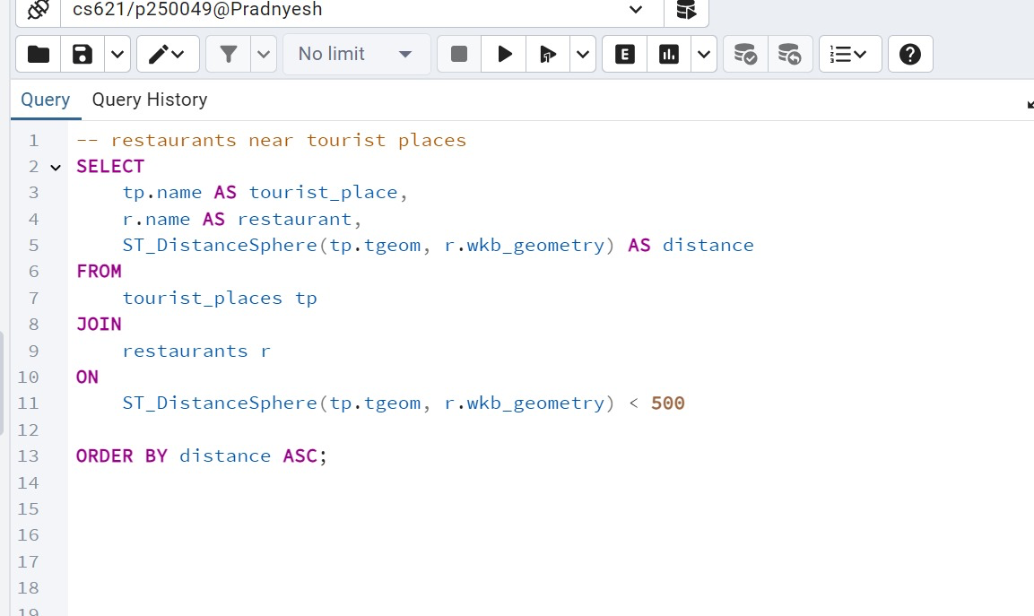

Slide 6
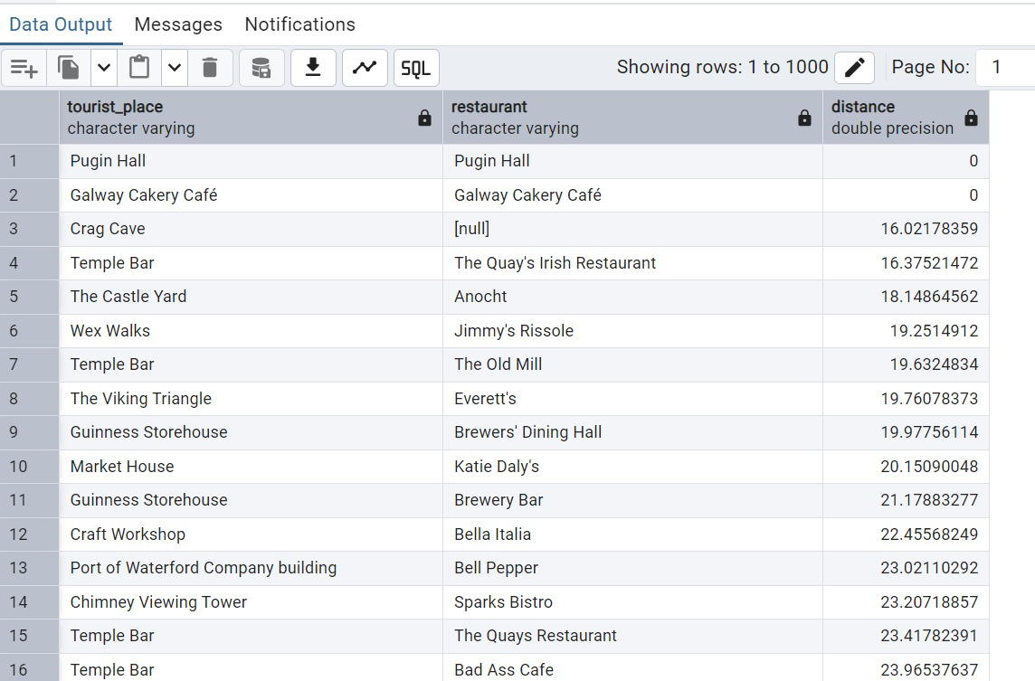

Slide 7
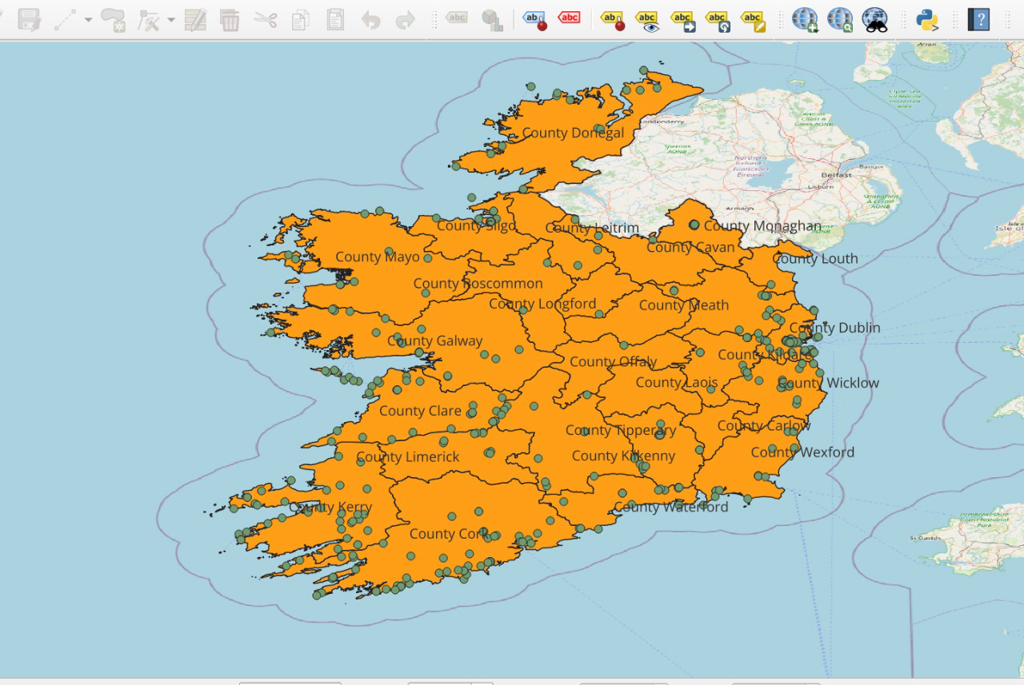

Slide 8
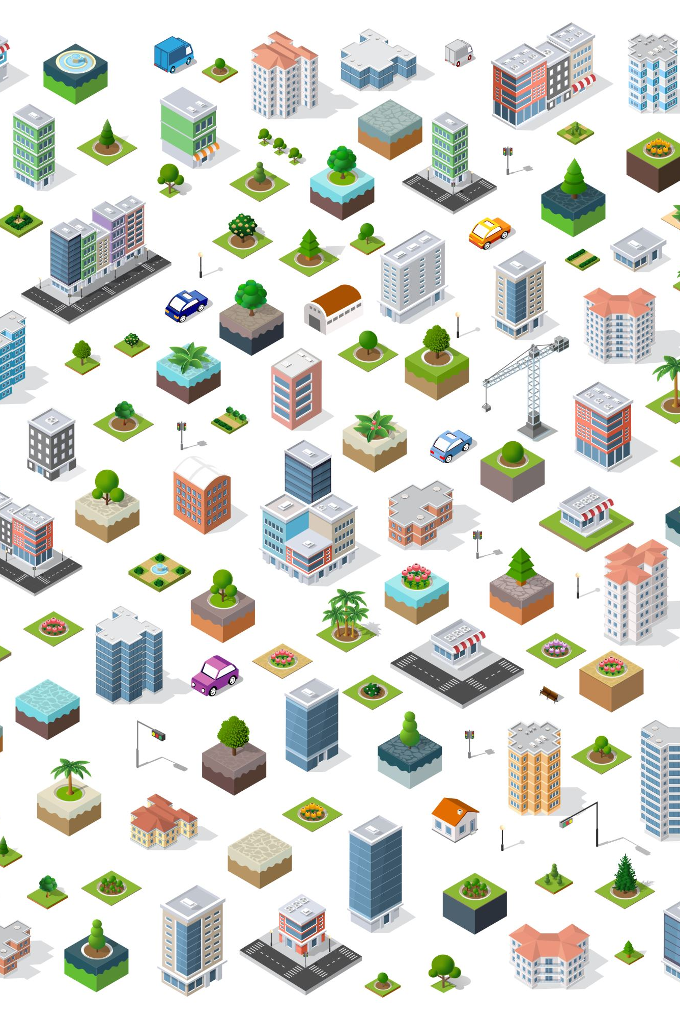
Query 2: Hotels Near Tourist Places
• Identifies hotels within 1 kilometer of tourist places.
• Output: Nearest hotels and their distances.
• Visualization: Green markers represent hotels within 1 km.

Slide 9
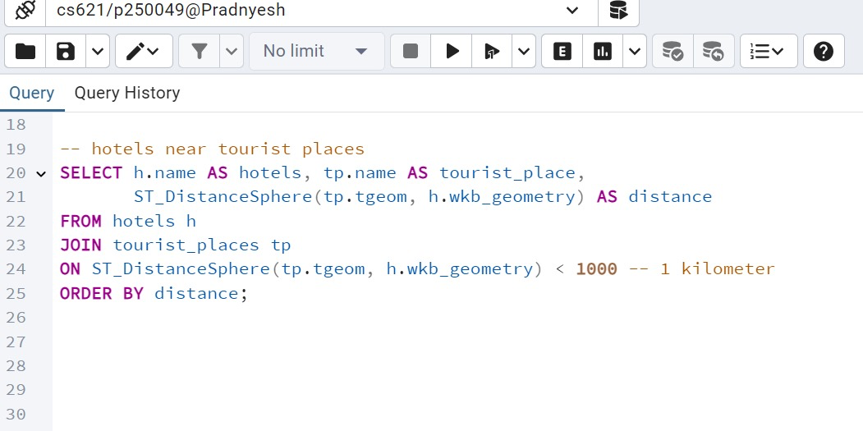

Slide 10
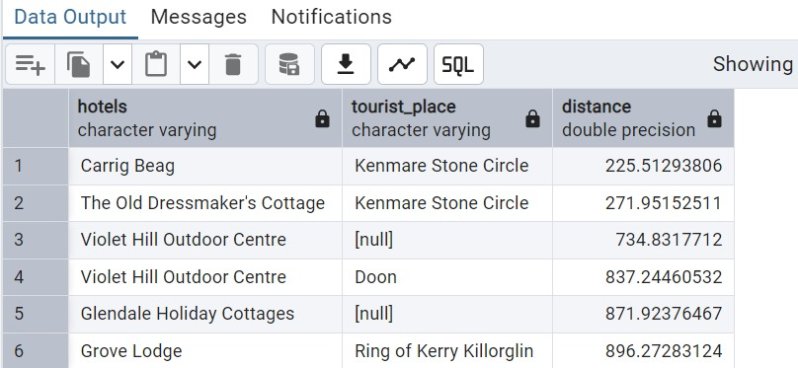

Slide 11
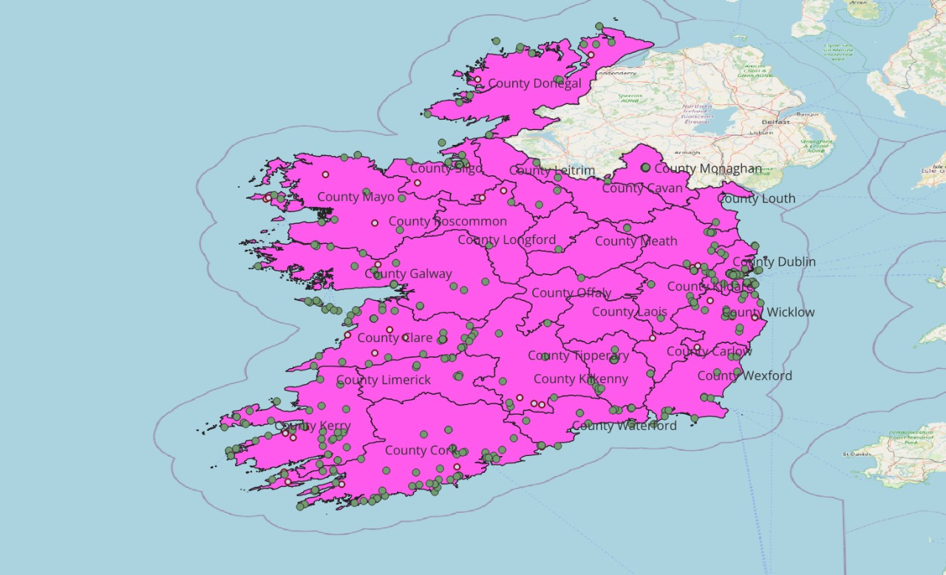

Slide 12
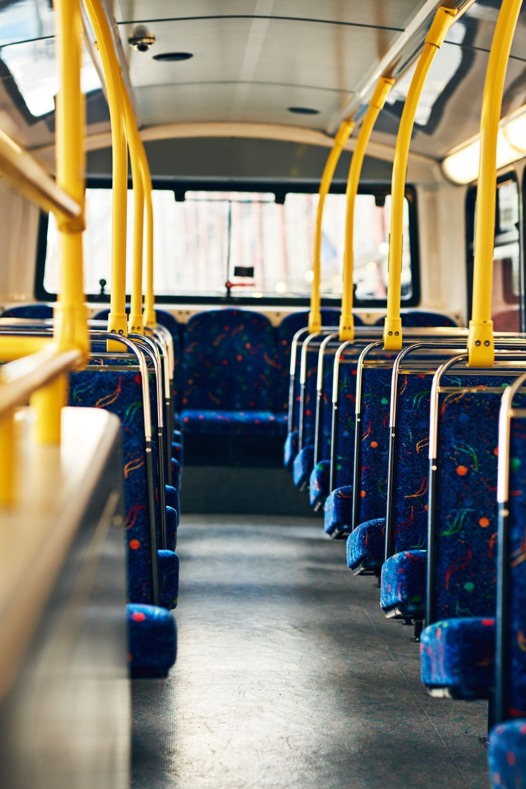
Query 3: Public Transport Near Tourist Places
• Identifies public transport within 300 meters of tourist places.
• Output: Nearest public transport options.
• Visualization: Yellow markers represent transport points within 300 meters.

Slide 13
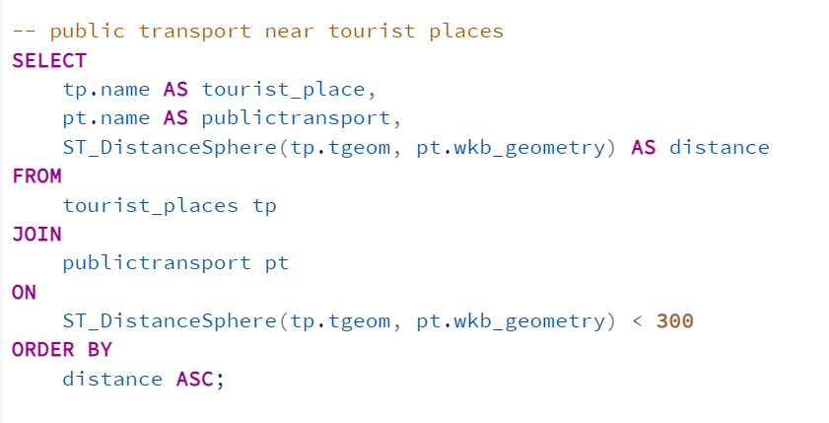

Slide 14
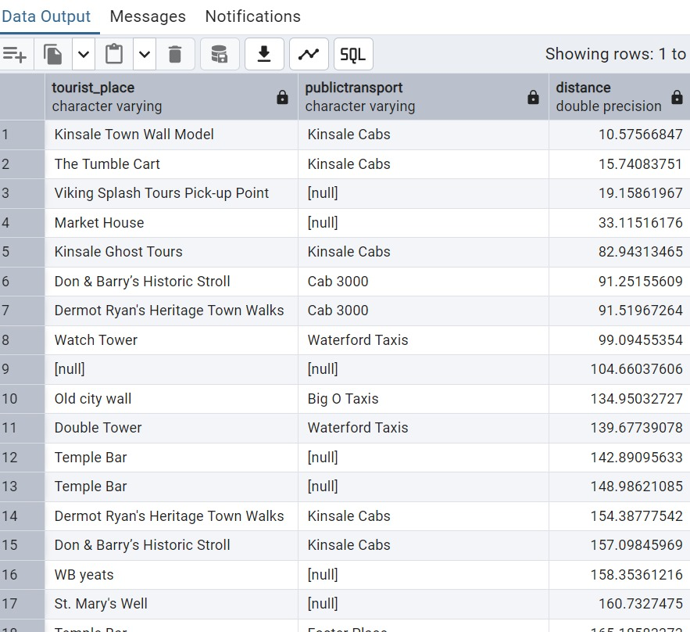

Slide 15
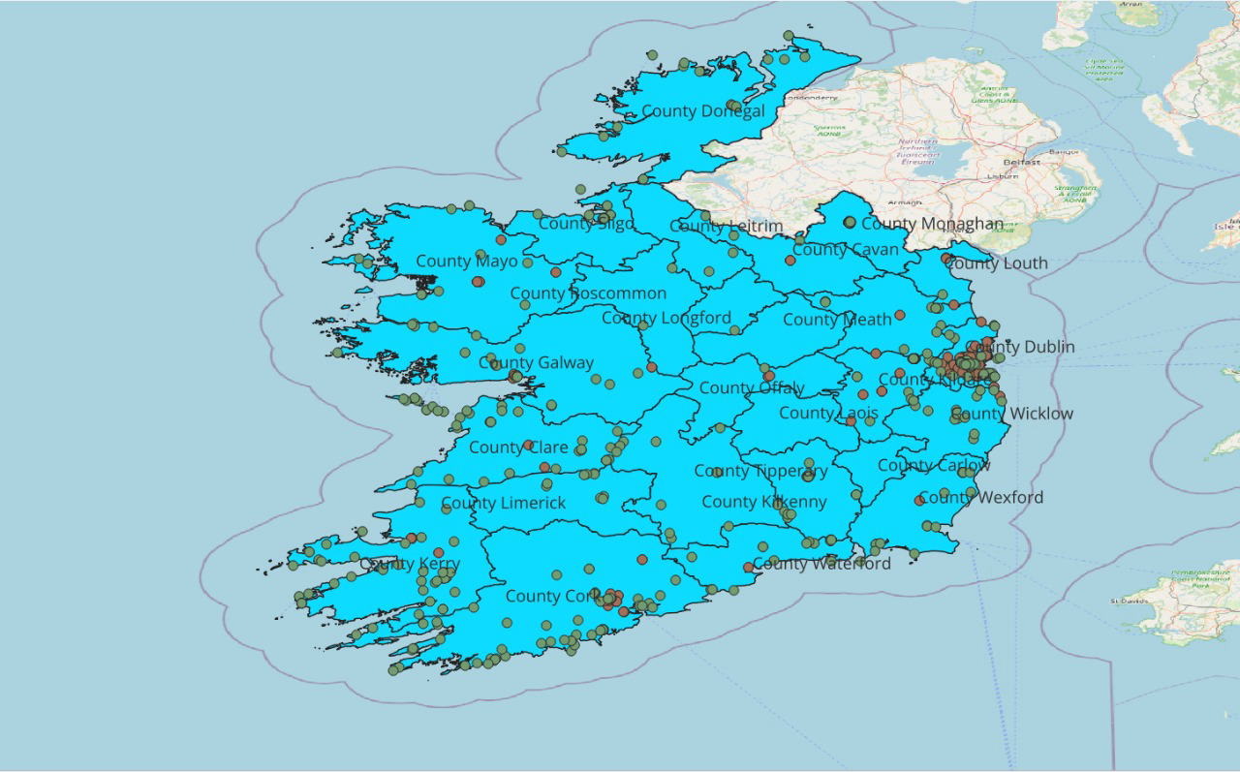

Slide 16
Comprehensive Query: All Amenities
• Combines restaurants, hotels, and public transport near tourist places.
• Visualization: Comprehensive map with all amenities.

Slide 17
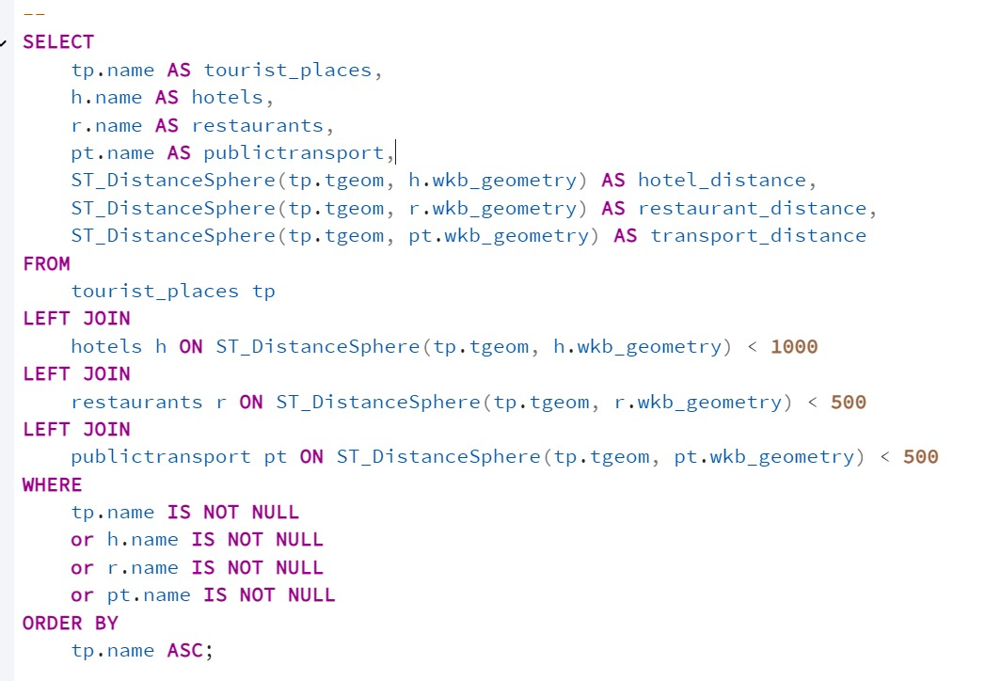

Slide 18
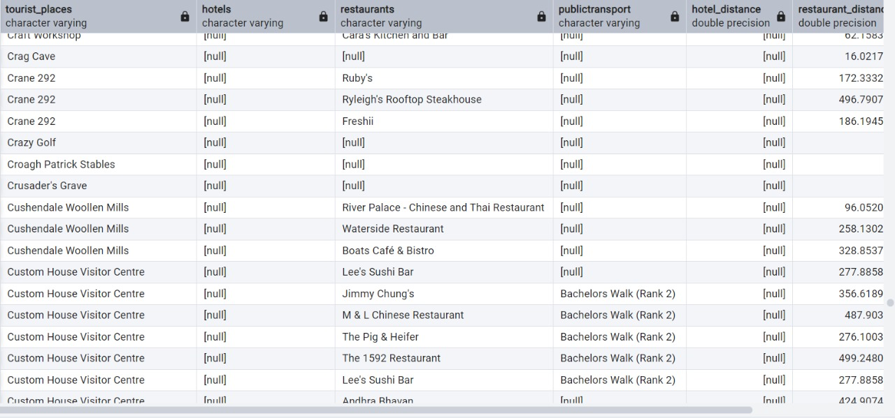

Slide 19
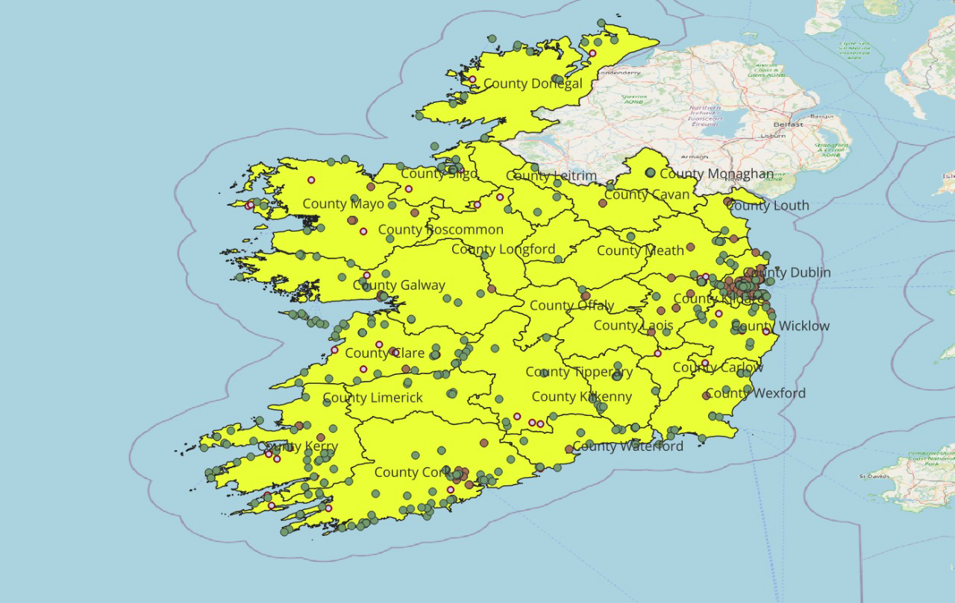

Slide 20
Practical Applications
• Tourism Benefits:
- Helps travel apps recommend nearby amenities.
- Assists tourists in planning their visits efficiently.
• Urban Planning:
- Highlights underserved areas.
- Provides insights for infrastructure development.

Slide 21
Conclusion
• Showcased how spatial databases and QGIS visualize spatial data effectively.
• Queries provided insights into restaurants, hotels, and public transport.
• Applications in tourism and urban planning demonstrate real-world value.
Thank you for watching this presentation! Feel free to reach out with questions.

